Slide 1


DARS
Data Analysis for Recommender System

Slide 2

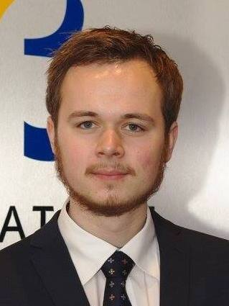

Sofia Vazquez Alferez
sofia.vazquezalferez@maastrichtuniversity.nl
Raphaël Morsomme
raphael.morsomme@maastrichtuniversity.nl

Slide 3

Content
Introduction to DARS
The Recommender System
Results
Looking Forward

Slide 4
Introduction to DARS
September 2018
Course recommender system for students
Wider impact
Supporting team
MSLAS

Slide 5
The Recommender System
Material
Alumni’s curriculum
Course material (course manuals, courose literature, …)
Content of other programs
External information
Techniques
Pattern sequence mining
Topic modelling
Data visualization
Datamining
Current profile
Heat map
Stated interests
Red flags
Intended grad.
Explanations

Slide 6
Pillar 1: Topic Modelling
Goal:
Material:
Course materials (course manual and course literature)
Technique:
Topic Modelling
Compare content of current profile v. intended gad. and interests
Stated interest s and intended grad.

Slide 7
Pillar 2: Pattern Sequence Mining
Goal:
Material:
Alumni’s curricula (time and grade)
Technique:
Pattern Sequence Mining
Identify (un)successful paths in the curriculum

Slide 8
By-products for Management (Quality Control)
Distribution of courses during the year
Level of courses within clusters
Aims of the degree covered by graduates
Assessment types covered by graduates
Content recommendation
…

Slide 9
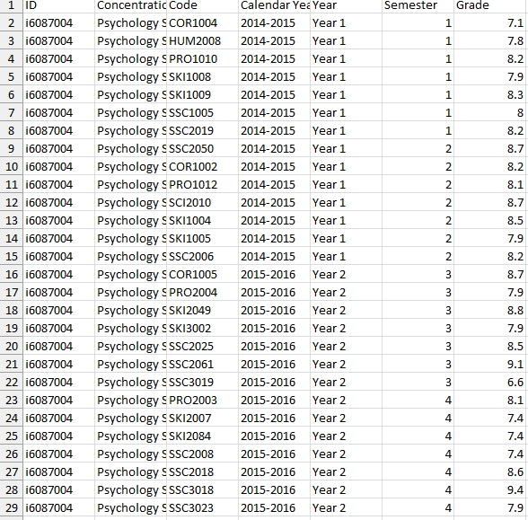
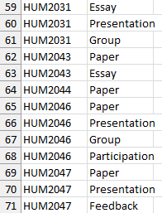
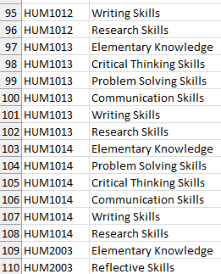
Results – Materials
Course catalogue
(Course manuals)
(Course literature)

Slide 10
Results – Plots (Laptop)

Slide 11
Looking Forward
PSM
TM of course manuals, course literature
TM of other programs
TM of leading institutions
Courses’ intended learning objectives
…

Slide 12
Thank you!
Sofia Vazquez Alferez
sofia.vazquezalferez@maastrichtuniversity.nl
Raphaël Morsomme
raphael.morsomme@maastrichtuniversity.nl

